Slide 1
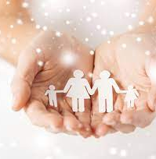
Early Childhood in Society
(Graduate Practitioner)
Welcome to the Department for Children and Families

Slide 2

Introductions

Slide 3

Teaching approaches/ delivery

Slide 4
Discussion
Do you think children learn better when they think the teacher likes them?
Do you agree that “good teachers are keenly aware that they might have devastating effects or uplifting effects on their students. Some of these effects last, or at least are remembered, for a lifetime.”? (Noddings 2003, p. 249) (2nd ref)
Good teaching is therefore relational?
Notes:
“Working with young children, good teachers are keenly aware that they might have devastating effects or uplifting effects on their students. Some of these effects last, or at least are remembered, for a lifetime. This first great good of teaching—response‐ability and its positive effects—is clearly relational. Teaching is thoroughly relational, and many of its goods are relational: the feeling of safety in a thoughtful teacher's classroom, a growing intellectual enthusiasm in both teacher and student, the challenge and satisfaction shared by both in engaging new material, the awakening sense (for both) that teaching and life are never‐ending moral quests.”
students need and want teachers to care for them as persons and to convey this care through listening and responding to their expressions of concern (Noddings, 1992a, 1999). It matters to students whether or not they like and are liked by their teachers. The teacher as person is centrally important in teaching.
“Teaching is thoroughly relational, and many of its goods are relational: the feeling of safety in a thoughtful teacher’s classroom, a growing intellectual enthusiasm in both teacher and student, the challenge and satisfaction shared by both in engaging new material, the awakening sense (for both) that teaching and life are never-ending moral quests.”

Slide 5
How would the session progress?
World Cafe
Buzz Groups
Fish Bowls
Case Study
Posters
Creating a story

Slide 6
Course Modules
What you’ll study and why

Slide 9
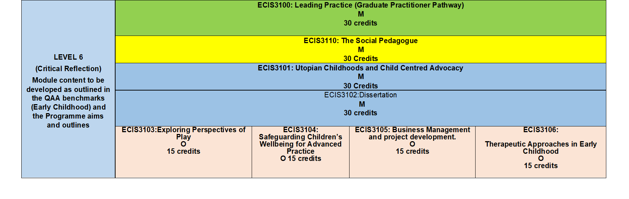

Slide 10
Practice Based Learning
Overseas Opportunities

Slide 11

Where might this take you?
Family Support Work
Work within Charitable Organisations
Teacher
Adoption and Fostering Agencies
Therapeutic Play Facilitator
Social Worker
Residential Care Staff
Nursery Worker/ Owner/ Manager
Work with Refugee families/ children

